Slide 1




BIRAJEE TRAVELS
BIRAJEE
Travels
Name : Puspendra Birajee
Roll No: 22A91A05J7
COURSE NAME : INTERNSHIP
FACULTY NAME: A. PHANI SRIDHAR, M.TECH,(PH.D)

Slide 2


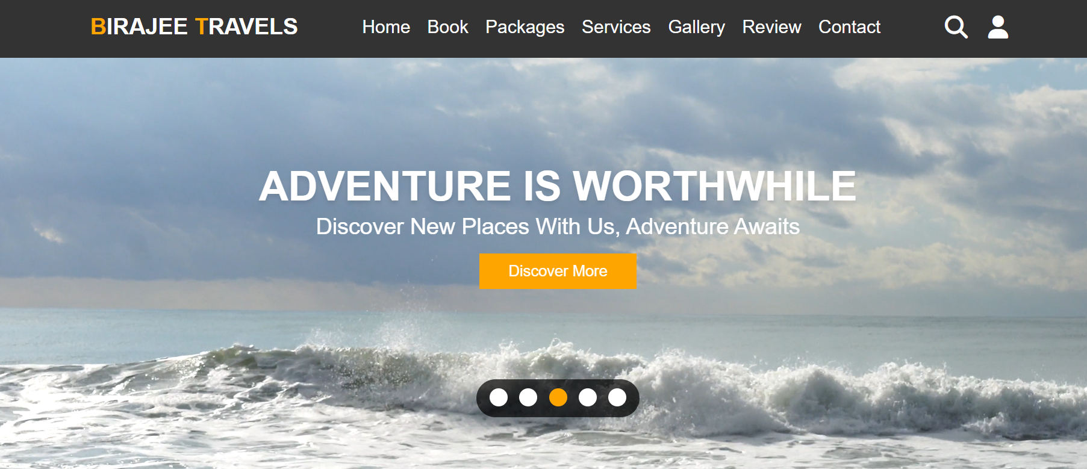
BIRAJEE TRAVELS
contents
Introduction
About Us
Our Services
Destinations
Packages & Pricing
Booking System
Photo Gallery
Contact us

Slide 3



BIRAJEE TRABELS
introduction
Welcome to Birajee Travels
Your gateway to adventure and exploration
users can easily book their dream vacations, find affordable hotels, and enjoy amazing services
How To Join The Trip
Join the trip through online

Slide 4

BIRAJEE TRAVELS
About us
Mission is to make travel planning simple, affordable, and enjoyable.
Dedicated to helping travelers explore the world by offering a one-stop solution for all travel needs.
Book accommodations, meals, guided adventures, and more, ensuring a memorable and hassle-free travel experience.
Services to both solo travelers and groups, making sure every journey is unique, safe, and exciting.
Mission: To inspire and enable people to discover new places and experiences with ease, affordability, and quality service.

Slide 5
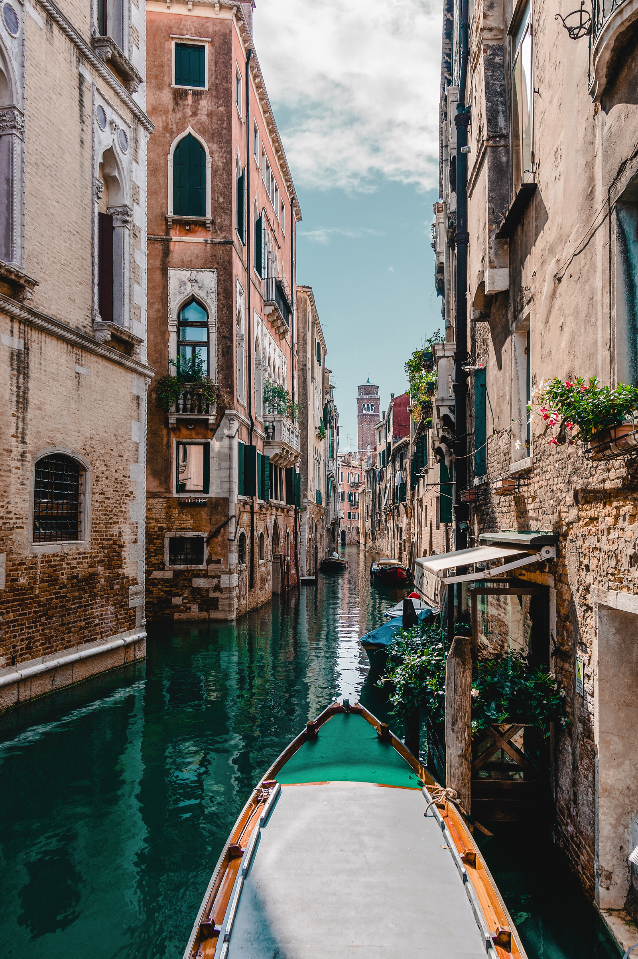
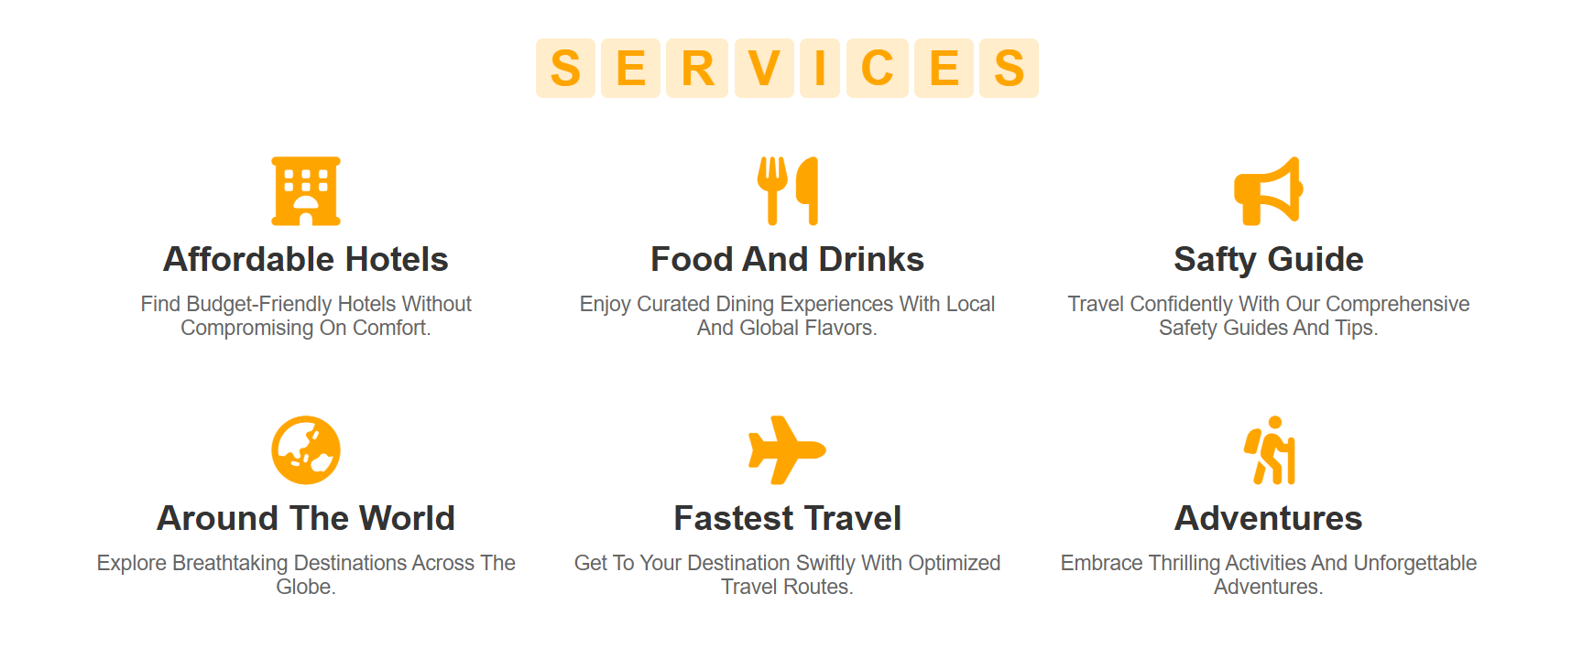

Slide 6




BIRAJEE TRAVELS
The Best
Destination wedding
Destination Place
Mumbai: Experience the vibrant city life, rich history, and coastal beauty of Mumbai. Perfect for urban explorers and food enthusiasts.
Hawaii: Immerse yourself in paradise with breathtaking beaches, lush landscapes, and unique Hawaiian culture. Ideal for relaxation and adventure.
Sydney: Visit iconic landmarks like the Sydney Opera House and enjoy Australia’s diverse wildlife and coastal beauty.
Beach
Paris: Discover the romance, art, and culture of Paris. From the Eiffel Tower to world-renowned cuisine, Paris promises unforgettable memories.

Slide 7



BIRAJEE TRAVELS
Packages and Pricing
Mumbai : Starting at $90 (Originally $120)
Includes 3-day city tour, hotel stay, and meals.
Hawaii : Starting at $90 (Originally $120)
Beachfront accommodations, island excursions, & traditional Hawaiian meals.
Sydney : Starting at $90 (Originally $120)
Includes a tour of the Sydney Opera House, harbor cruise, and more.
Paris : Starting at $90 (Originally $120)
Guided tours to the Eiffel Tower, Louvre Museum, and fine dining experiences.
Why Book with Us?
Competitive prices
Quality accommodations
Customized experiences for every traveler

Slide 8



BIRAJEE TRAVELS
Booking system
Select your destination : Browse through our list of destinations
Choose the place that excites you.
Enter Travel Details : Where to: Choose your destination
How Many: Specify the number of guests
Arrival & Departure Dates: Select your travel dates
Get Instant Confirmation : Receive an email confirmation with all your booking
Details for easy reference.

Slide 9





BIRAJEE TRAVELS
Photo Gallery
MOre Happines With Us
Best Holiday
around The World
travel planner
awesome Destination
Capture your perfect holiday moments with us
Experience the beauty of diverse cultures and landscapes.
Plan your dream journey with personalized travel insights.
Explore awe-inspiring locations and create lasting memories.

Slide 10


BIRAJEE TRAVELS
Contact
Get in touch :
WE’D LOVE TO HEAR FROM YOU! WHETHER YOU HAVE QUESTIONS, NEED MORE INFORMATION, OR ARE READY TO START PLANNING YOUR ADVENTURE, REACH OUT TO US.
Contact Details:
📍 Address: Nepal, India, USA, France
📞 Phone: +91-6387629947
✉️ Email: puhspendra02134@gmail.com
🌐 Website: www.birajeetravels.com
+91-6387629947
pushpendra02134@gmail.com

Slide 11


BIRAJEE TRAVELS
Thank
YOU
for your attention

